Slide 1
Better Horror Movie Genres
Emma Kent

Slide 2
AGENDA
The problem with “horror”​
Data Collection and Preprocessing
K-means Clustering: Uncovering Subgenres
Visualizing Clusters: Genre Insights
Benefits and Implications
Conclusion and Q&A

Slide 3
THE Problem
Imagine thinking about "horror movies." Does "Saw" come to mind? Or maybe "The Conjuring," "28 Days Later," or "Get Out"? These films might give you chills, but beyond that, they're vastly different. How can you predict what awaits you without more precise categorization?
In a world where horror movies span countless themes and styles, the challenge lies in crafting a meaningful movie-watching experience.

Slide 4
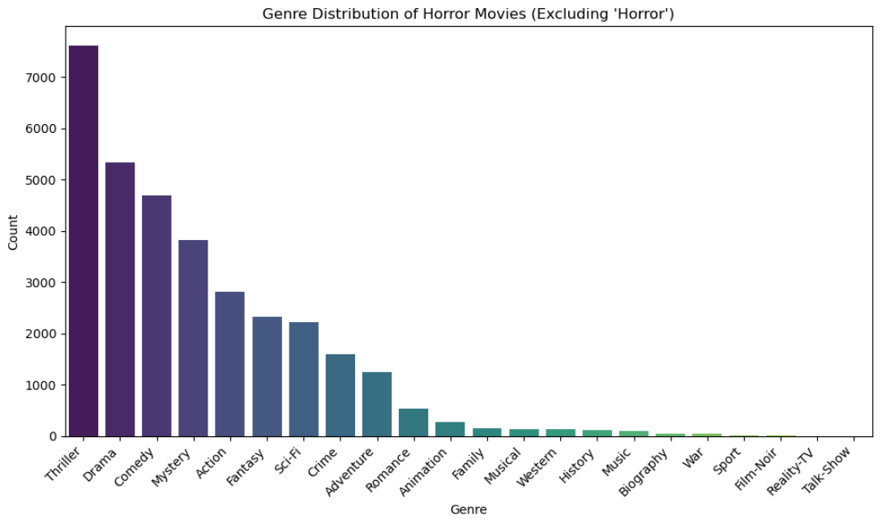
Typical “Genres” from IMDB

Slide 5
A More Tailored Scare
How can we give you a better fright, using data?

Slide 6
THE Solution
The solution lies in leveraging data-driven techniques like k-means clustering and natural language processing (NLP). By analyzing IMDB movie descriptions, we aim to uncover hidden connections and patterns.
Our goal? To create a more refined and accurate classification of horror movie subgenres. This approach empowers filmmakers, studios, and audiences with deeper insights, transforming how we appreciate and enjoy horror cinema.
Through this project, we're on a journey to make horror movie categorization not just scarier, but smarter. Join us as we explore how data can transform the way we understand and engage with one of cinema's most thrilling genres.

Slide 7
The issues with the data
The list of films
The descriptions
Language Barrier: Dealing with movies in languages other than English, which required translation and language processing.
Incomplete Descriptions: Managing films with missing or incomplete descriptions, impacting their analysis.
Filtering Relevance: Identifying and excluding movies with descriptions lacking substantial content or context.
Ambiguous Content: Navigating movies with vague or ambiguous descriptions that hindered accurate categorization.
Stopwords and Noise: Removing common stopwords and noise words to extract meaningful information from descriptions.
Redundant Phrases: Addressing repeated phrases like "yet to be released," which didn't contribute to the analysis.
Data Uniformity: Ensuring consistent formatting and cleaning across a wide range of movie descriptions.
Contextual Understanding: Extracting relevant details while considering the broader context of horror movie themes.

Slide 8

creating a usable list of films

Slide 9
Horror movies amplify unheard stories, defying norms to unveil the profound complexities of humanity.
“
”
Chat GPT, providing a “quote”

Slide 10
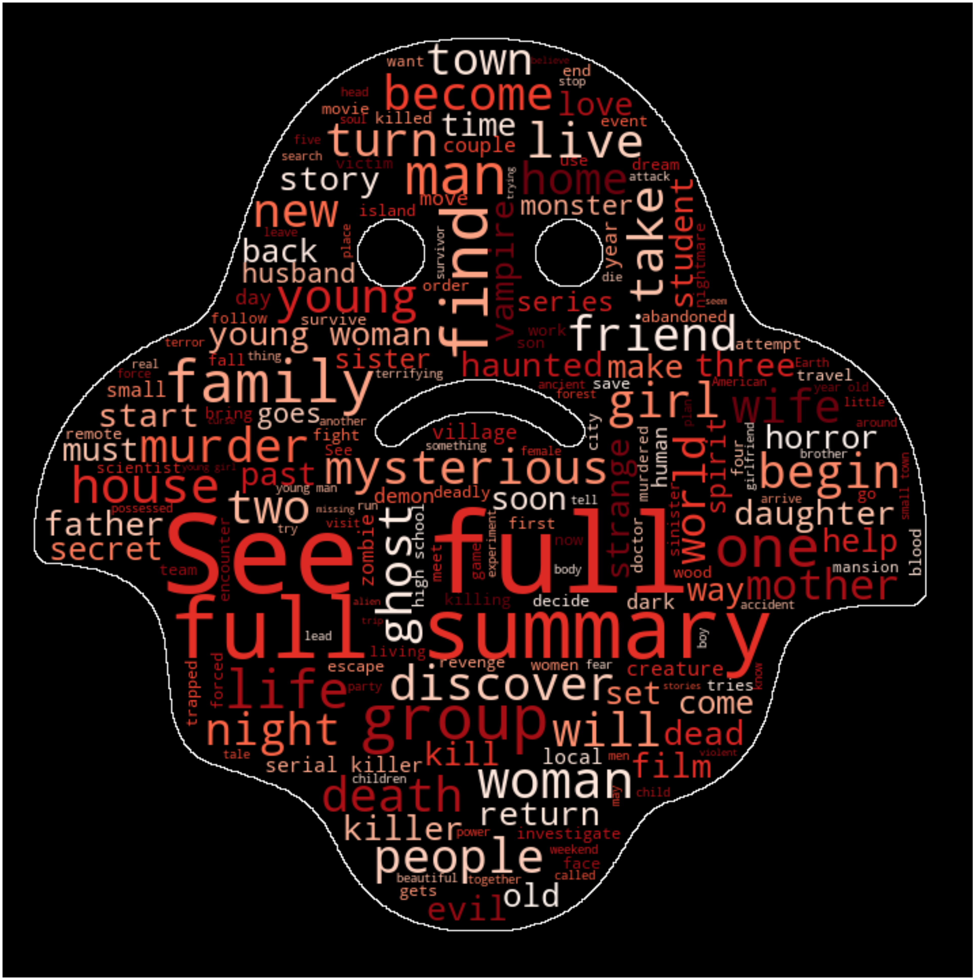
Before cleaning

Slide 11

After cleaning

Slide 12





PLAN FOR Creating genres
K Means Clustering
The Elbow Method
Limited Range Elbows
Adapting to complexity
Domain Expertise
Unsupervised algorithm for data grouping
Optimal clusters through inertia vs. cluster count plot
Unclear bend complicates cluster selection
Blend data insights with domain knowledge
Contextual choice aligns with horror subgenres

Slide 13
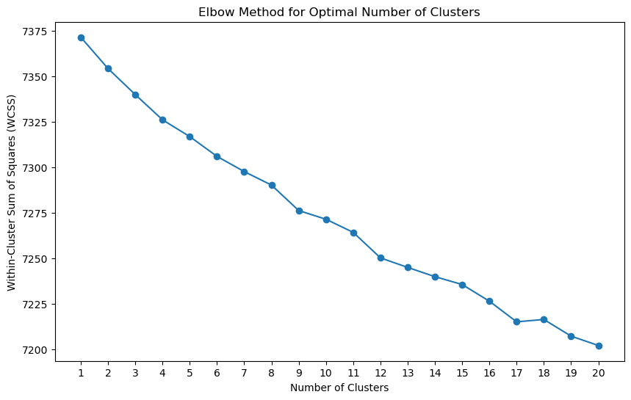
The unclear elbow
Opportunity #1
Explore the number of clusters more

Slide 14
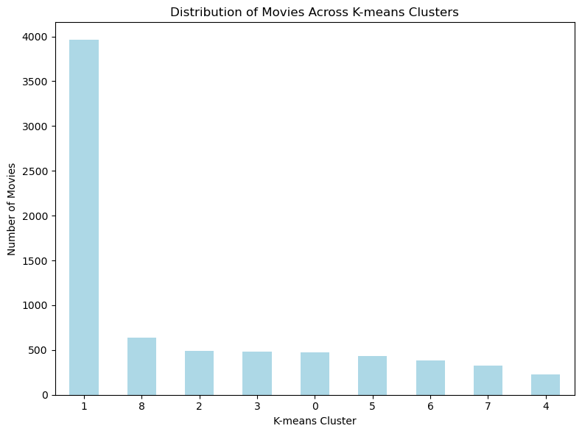
Variation in clusters
Opportunity #1
Explore the number of clusters more

Slide 15
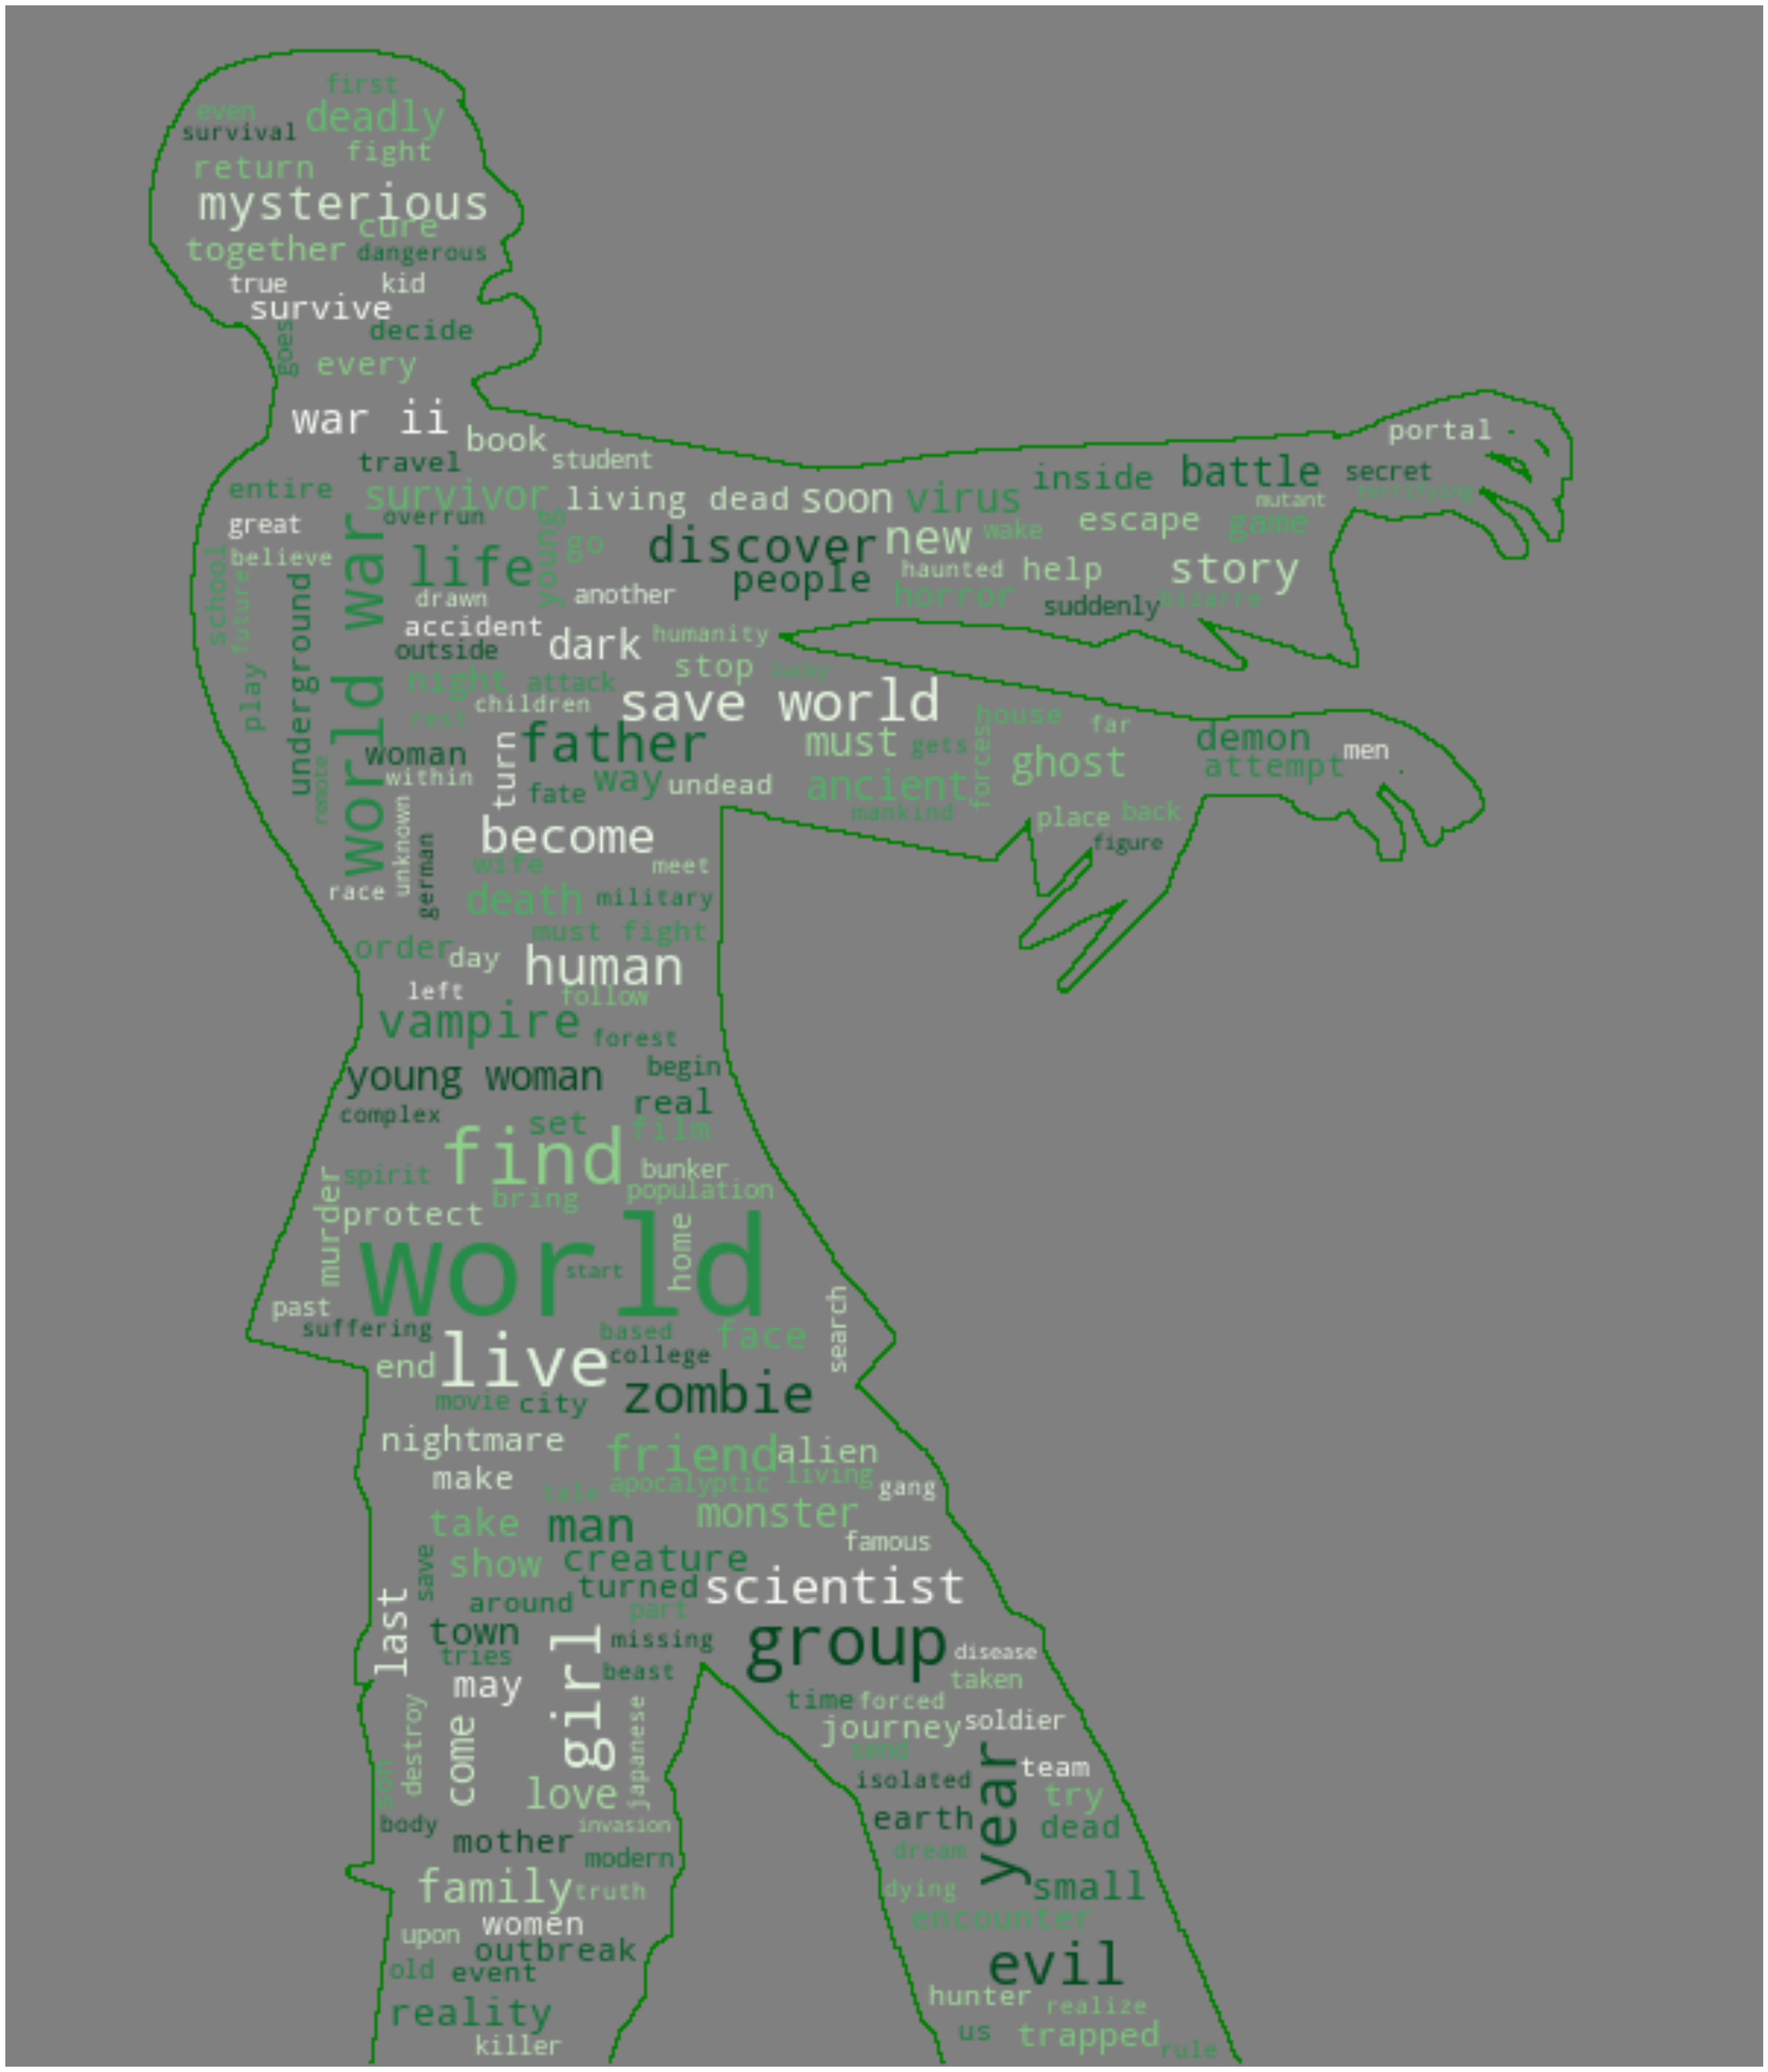
Years of experience
Warm Bodies
Day of the Dead
World War Z
Alone

Slide 16
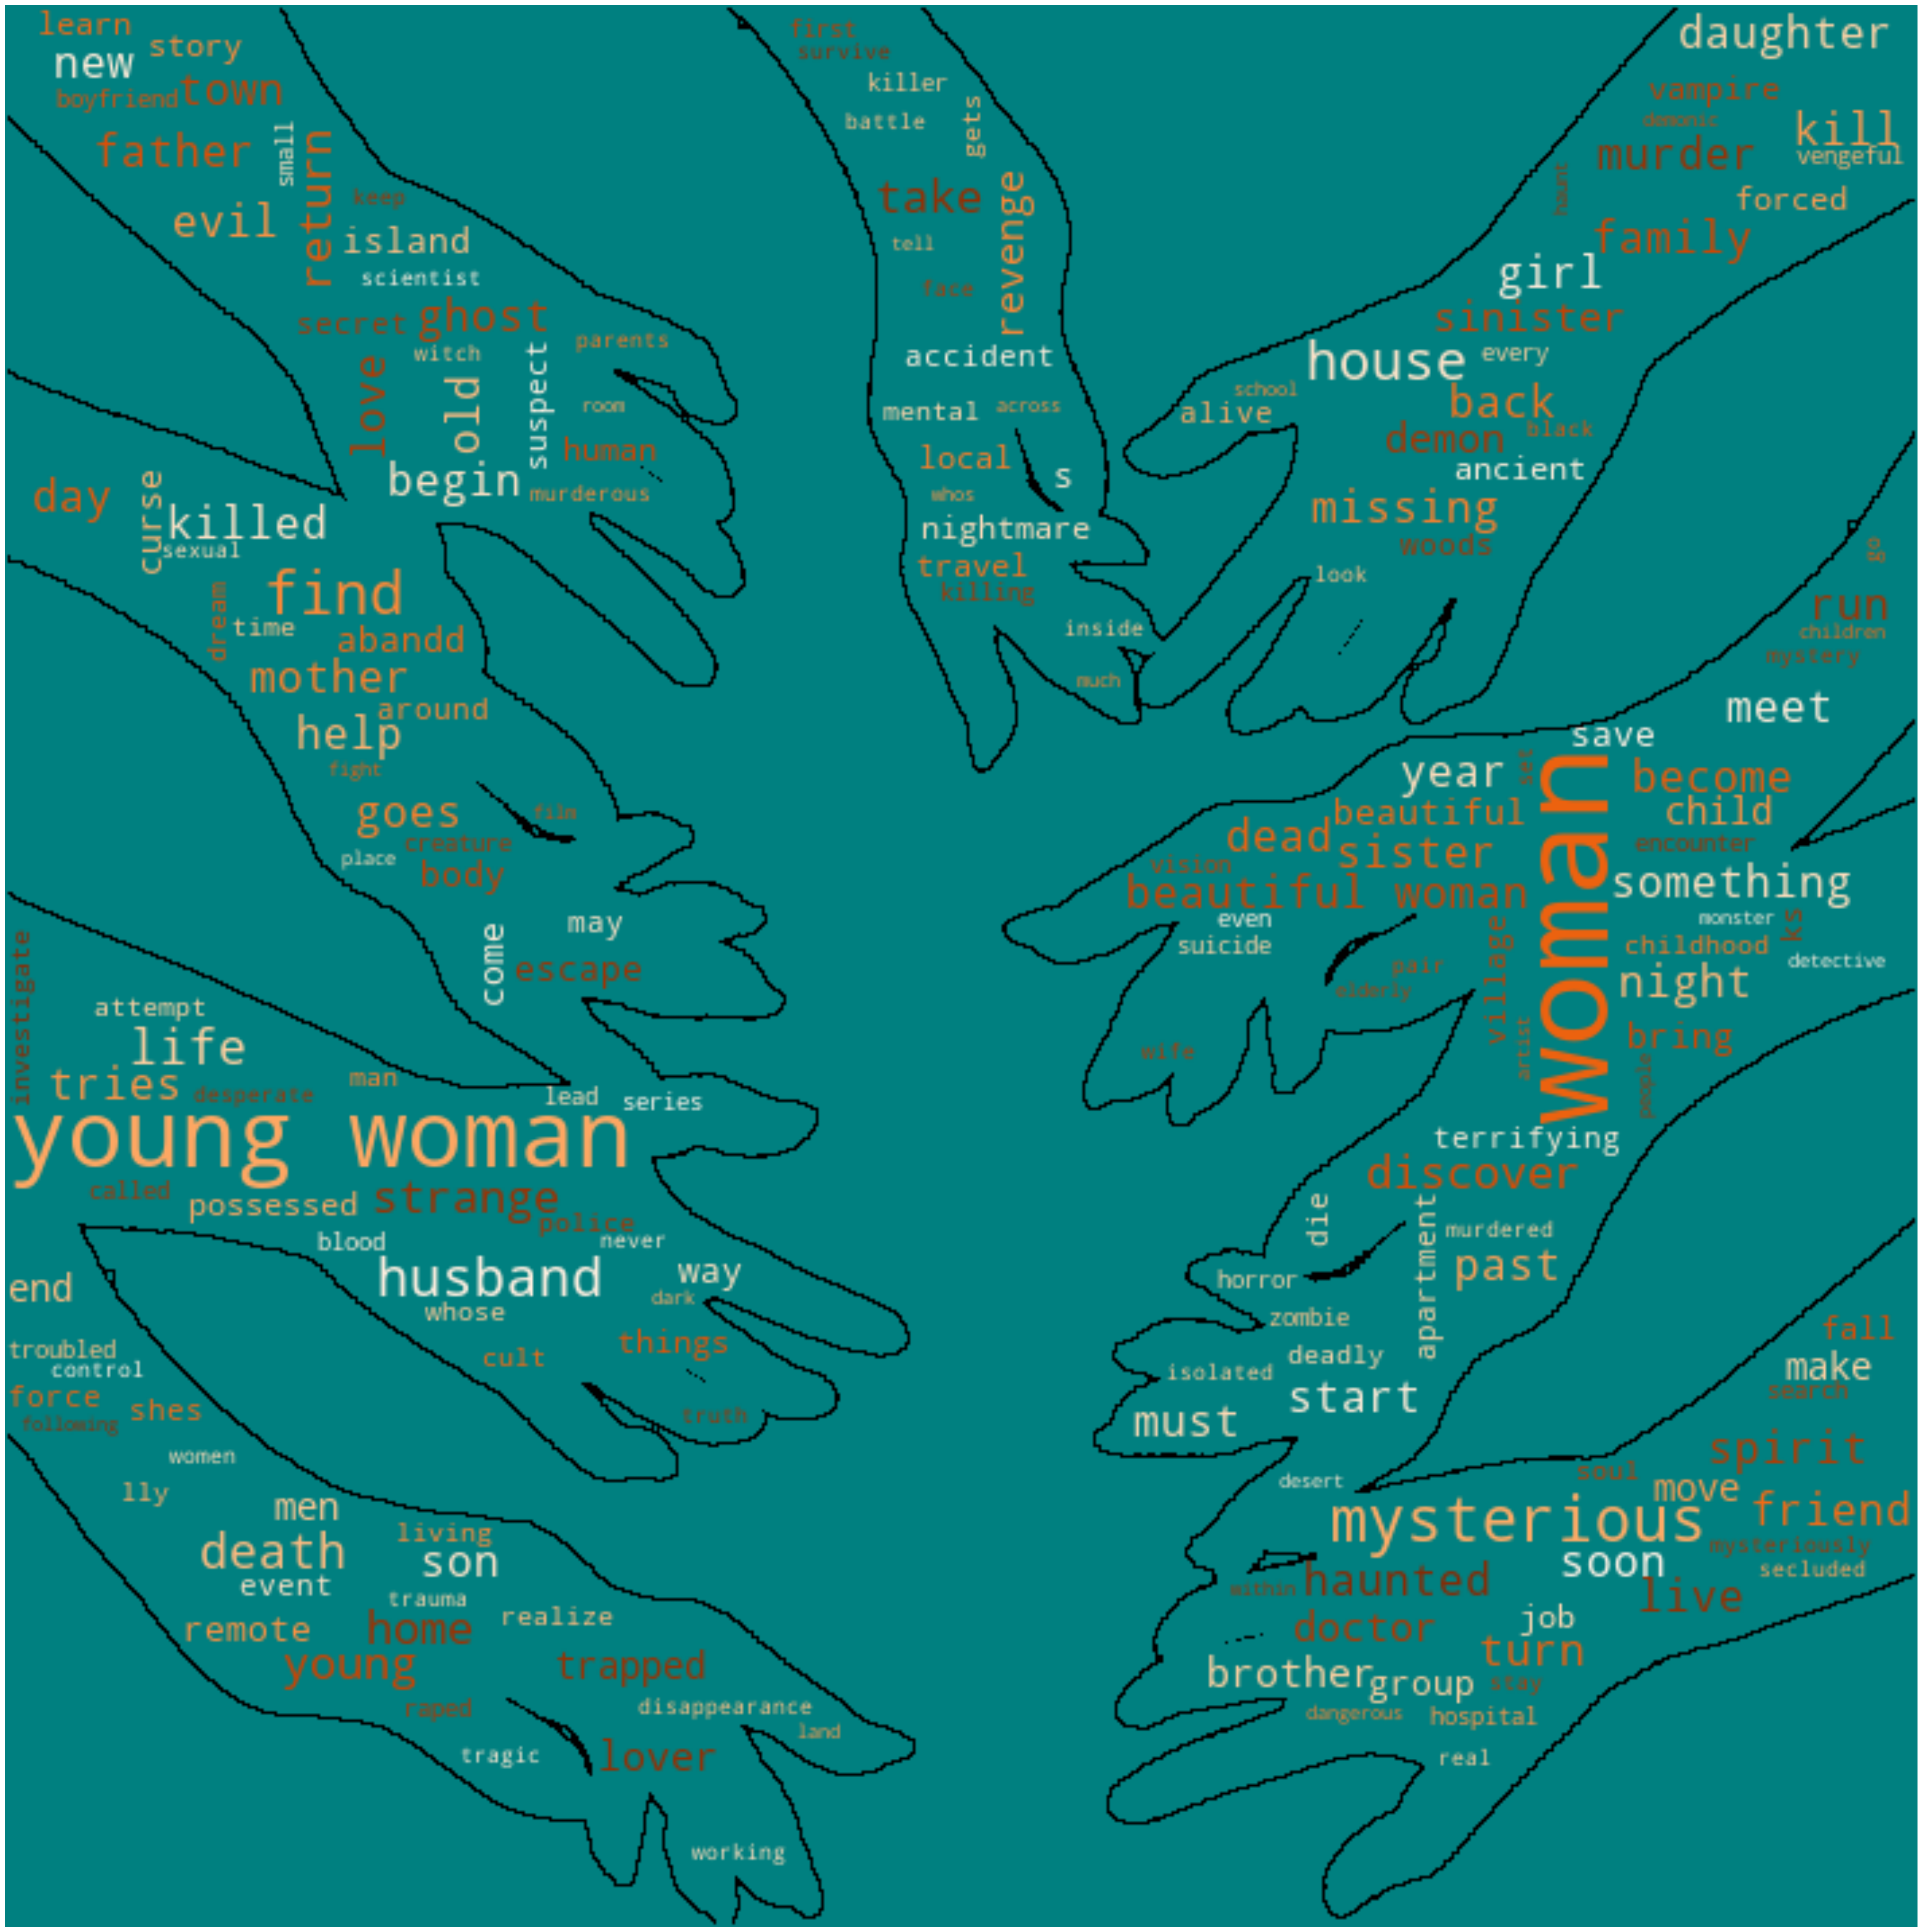
Years of experience
The Descent
The Ring
Babadook
It Follows
Notes:
Psychological horror

Slide 17

Years of experience
Dahmer
The Poughkeepsie Tapes
The Zodiac

Slide 18
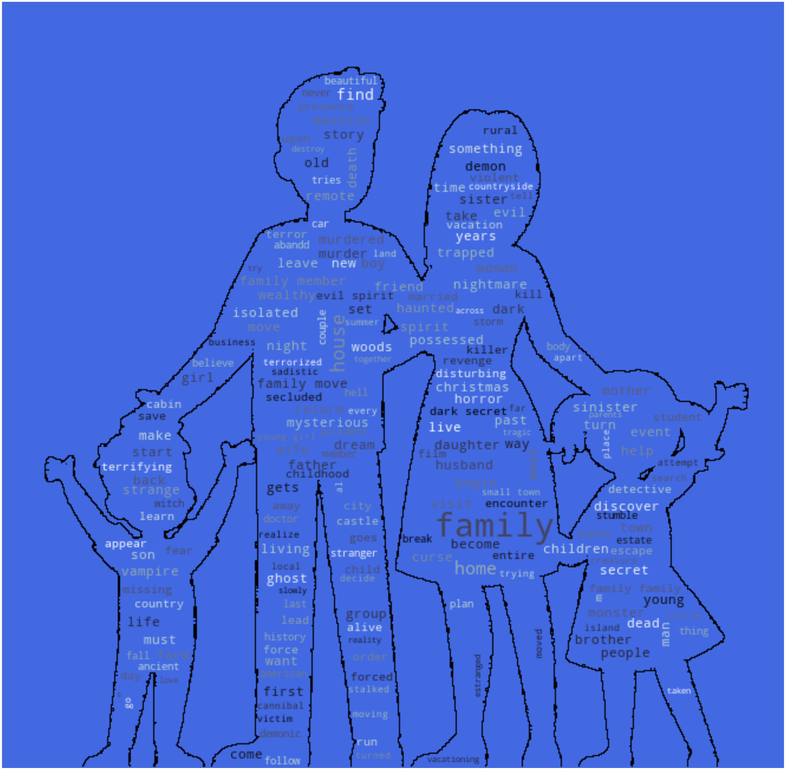
Years of experience
Conjuring
The Others
Paranormal activity
The Shining

Slide 19
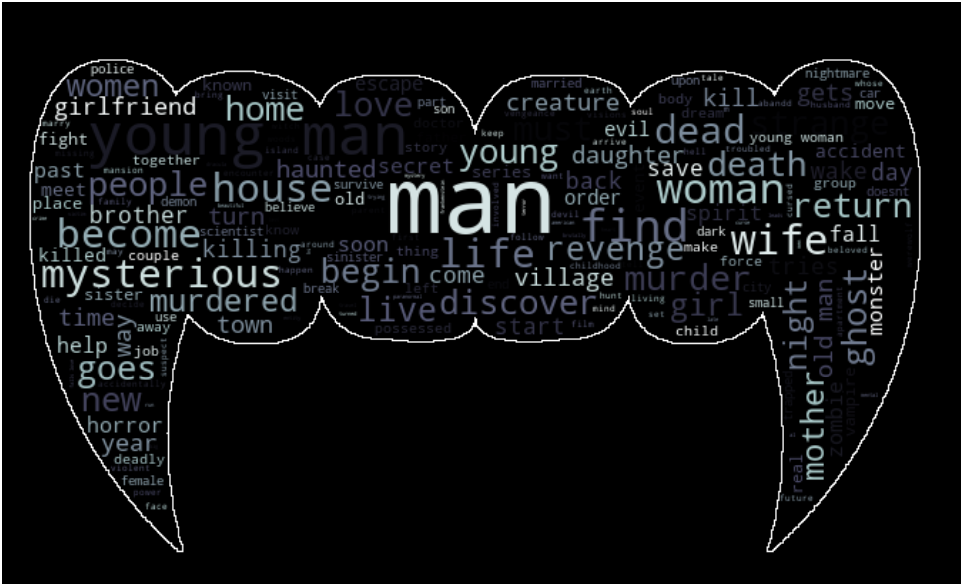
Years of experience
Dracula
Let the Right One In
Blade
Underworld

Slide 20



Next Steps
LDA
Number of Clusters
Richer Data
Envision multimedia-based expertise and cross-media growth strategies
Visualize quality intellectual capital
Engage worldwide methodologies with web-enabled technologies
Pursue scalable customer service through sustainable strategies
Engage top-line web services with cutting-edge deliverables
Cultivate one-to-one customer service with robust ideas
Maximize timely deliverables for real-time schemas

Slide 21
SUMMARY
Insert summary here

Slide 22
THANK YOU
Emma Kent

